Slide 1


Chart Review
Snapshot
BPAs
PDMP
Pt. Name
Pain Manager:
New patient data available.
Pain Manager:
New patient data available.
Notes:
11.2 Chris Notes – (1) agree defer to Chris C/Francisco as they build in Epic and we go through detailed discovery and requirements with them. (2)-(4) I think these are best answered in working sessions b/w Alphora and UF Health Epic/IT teams once UF Health IT has Version 1.0 applications up and running in test environment.
---@Cara – let’s put this as a topic at next technical meeting (and next Alphora meeting).
Julie Notes 10.19:
decision to defer to Chris Catalano about best placement of BPA.
Need to confirm that pain manager can live on a center tab in Epic with Maggie’s team (Bill?).
Need to confirm that content from Pain Manager can be copy/paste into provider note without formatting issues. If formatting issues occur, is there anyway we can design the data to facilitate copy/paste?
Would be great if UF could provide Alphora with information on size of tab (I know it would vary based on provider screen, but there may be some rules of thumb that could help with design.)
//history//
Notes: This is a mock-up of the EHR. A BPA would appear on the screen. When providers click on it, the Pain Manager tab would come into focus in the center of the screen.
There are two different locations where the BPA alert can appear. PCPs were split on which location they preferred. Some didn’t like it on the left because they may need to scroll to see it. Some didn’t like the right because that is where they like to do notes. Another option is to put it both places, but this increases noise on screen.
Feedback:
Alphora:
Chris: Defer to Chris Catalano.
Francisco:
Laura:
Lori:
Ramzi:
Rob:

Slide 2
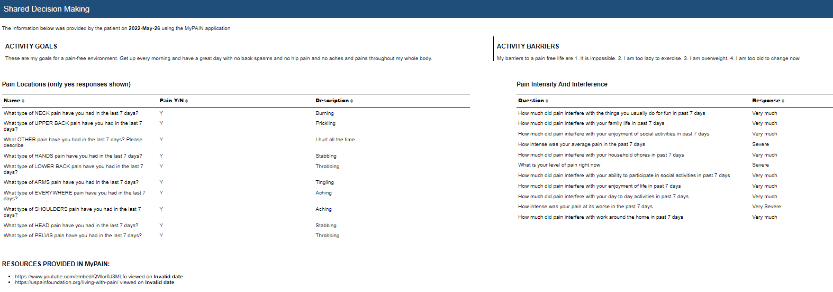
Before: Shared Decision Making section

Slide 3

Chart Review
Snapshot
Pain Manger
Note
PDMP
FROM PATIENT VIA MYPAIN (OCT 10, 2022):
FROM HEALTH RECORD:
Pt. Name
Pain & Goals Treatment Effectiveness
Conditions Medications Urine Drug Screen
Pain location to discuss at visit | Description
Low back | Burning
Neck | Prickling
Other | Finger pain
Pain Intensity | Response
Current Pain | Severe
Average Pain (past 7 days) | Moderate
At its worse (past 7 days) | Very severe
Pain Interference (past 7 days) | Response
Day to day activities | Very much
Work around the home | Quite a bit
Ability to participate in social activities | Somewhat
Household chores | Quite a bit
Things you usually do for fun | A little bit
Enjoyment of social activities | Somewhat
Enjoyment of life | Somewhat
Family life | A little bit
Activity Goals
I would like to keep walking daily and I want to go bowling once a week.
Activity Barriers
Sometimes I get defeated and do not walk if my back hurts.
Notes:
Chris Notes 11.2
1. Concur with these change
2. I understand this desire and believe Interference can be summarized numerically (not sure about intensity). However, clinicians can struggle with what to do with the number. Also, the aim of this tool is to help them engage in more nuanced discussion (as idealized as that is in a short visit). What about calling their attention to concerning sub-items? Let’s explore with Alphora whether they can highlight the sub-items that are “Quite a bit” or “very much” (with color or
@Julie – Can you recommend a relatively simple and appropriate visual design approach to call-out/highlight to clinicians any values that are Severe/Very Severe or Quite a bit/Very much? (e.g., boxes, asterisks, color, etc.) @Chris, yes, I put the two highest pain responses in red and bolded the very highest.
3. agree with Julie rec
Julie Notes 10.19:
Reformatted navigation to have patient reported data first, then data from the health record. Also added Goals to this section.
(2) Can we aggregate the pain interference questions to a single intelligible response for providers? For example: “Pain Intensity: Severe. Pain Interference: Quite a bit.”?
(3) Removed links to resources. We could add it back, but I think it makes more sense on the treatment effectiveness tab.
//history//
Notes: Pain location, intensity, and interference answers are on their own ‘MyPAIN’ tab. Formatted the table and streamlined text to aid readability.
Feedback:
Alphora:
Chris: maybe organize based on what is value-added from pain manager: patient reported date in mypain, goals, then treatments etc. Maybe what opens first is most relevant.
Francisco:
Laura:
Lori:
Ramzi:
Rob:
Cara: we did talk about the DVPRS and how it was preferred by most of the patients and providers. For now, we decided to stick with PROMIS because it would be a big change to switch from that.

Slide 4
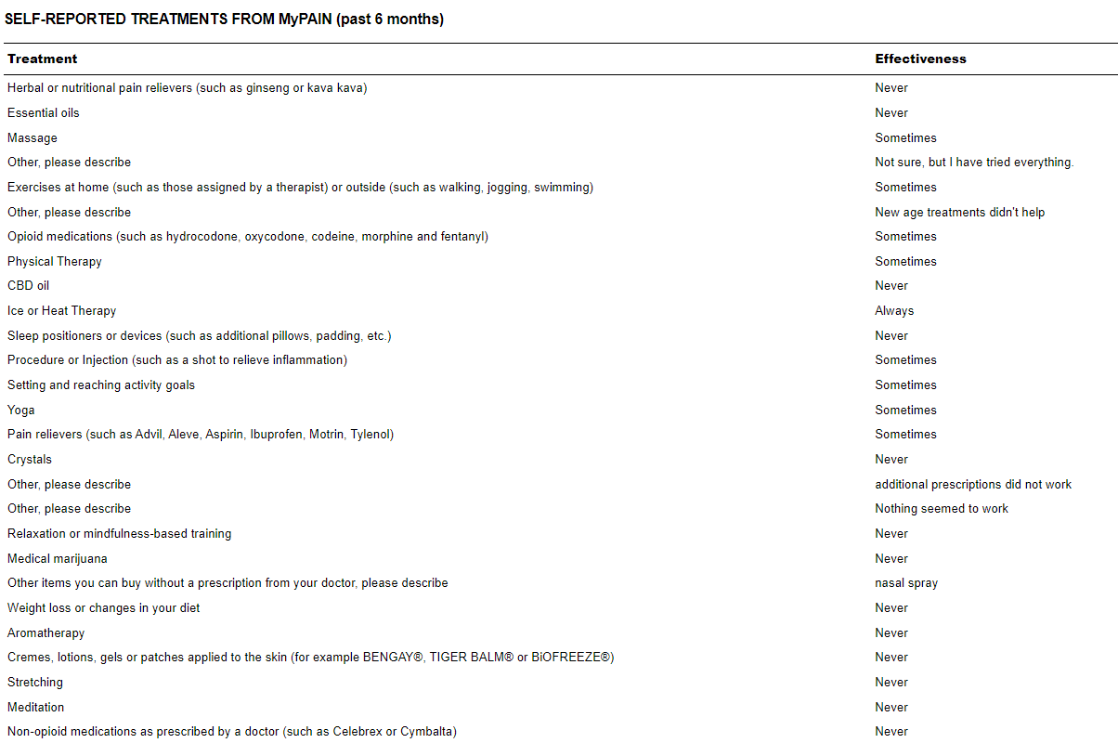
Before: Bottom part of Current Pertinent Treatments section

Slide 5
Chart Review
Snapshot
Pain Manger
Note
PDMP
FROM PATIENT VIA MYPAIN (OCT 10, 2022):
FROM HEALTH RECORD:
Pt. Name
Pain & Goals Treatment Effectiveness
Conditions Medications Urine Drug Screen
Not Tried
Sleep management
Acceptance or commitment therapy
Greatly Effective
None
Moderately Effective
Exercise
Prescription non-opioid medications
Slightly Effective
Creams
Not At All Effective
Physical therapy
Other
Tai Chi class helped a little but too far away
Notes:
Chris 11.2
@Julie – I like FMW’s recommendation, and I hope the grouping is doable by Alphora. Could we move the “not tried” section to the top so it’s more apparent when various options have not been tried? @Chris, yes, I moved ‘not tried’ to the top. One note of caution, this category is likely to be much bigger than the other categories. We may have to think about sub-categories to make it more readable.
Julie Notes 10.19: we did not have time to review this slide with the team. FYI Francisco suggested the switch to effectiveness categories.
//history//
Notes: Pulled the patient reported treatments and effectiveness out into its own section. This wireframe does not show all of the treatment options; this would be a page that would need to scroll. (1) Recommend sorting by effectiveness if possible. All items not rated by patient would be in the “not tried” section. Alternatively, we could sort by the same categories in MyPAIN. (2) Recommend using simplified text options over the longer treatment descriptions in Pain Manager.
Feedback:
Alphora:
Chris:
Francisco:
Laura:
Lori:
Ramzi:
Rob:

Slide 6
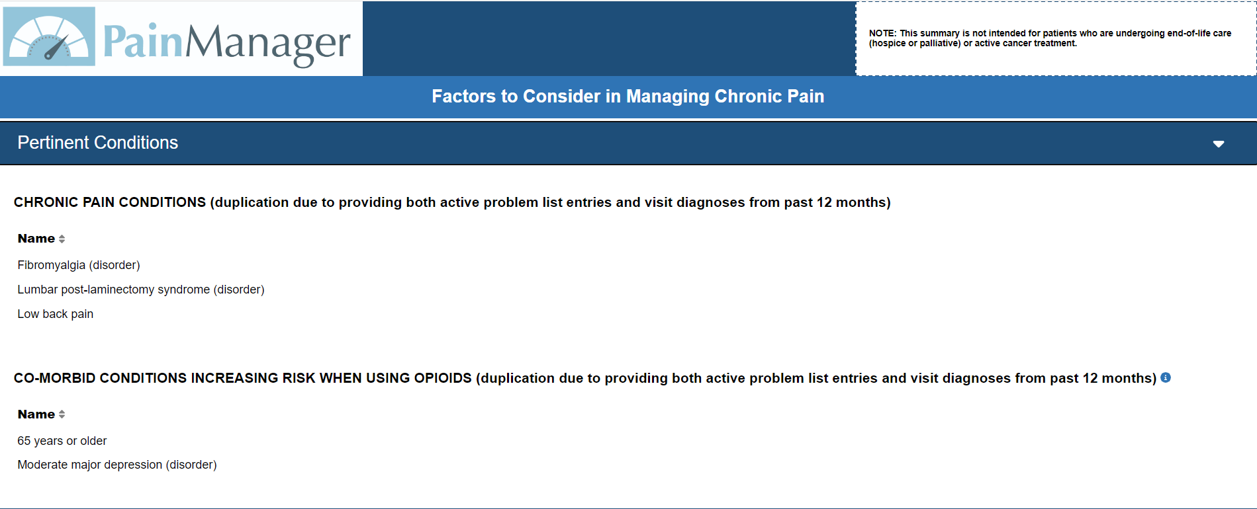
Before: Pertinent Conditions Section

Slide 7
Chart Review
Snapshot
Pain Manger
Note
PDMP
FROM PATIENT VIA MYPAIN (OCT 10, 2022):
FROM HEALTH RECORD:
Pt. Name
Pain & Goals Treatment Effectiveness
Conditions Medications Urine Drug Screen
Where is this data from? Problem list entries & visit diagnoses over past 12 months (may cause duplicates)
Chronic Pain Conditions
Fibromyalgia
Low Back Pain
Co-morbid Conditions (increasing risk when using opioids)
Moderate major depression
Over 65 years old
Pain Manager is not for patients undergoing end-of-life care or cancer treatment.
Notes:
Chris 11.2
I like the re-design!
Julie Notes 10.19: This is the conditions section. The biggest change is the switch to top navigation, so users do not need to scroll when vertical menu is open. PCPs told us they don’t like to scroll in Epic and that they sometimes miss information below the fold. There are 5 sections instead of 4 so there is less information in each section, which is another strategy to reduce scrolling. The names of each section, the order, and which one is open by default is something to provide feedback on. The disclaimer is moved to the bottom to save space at the top. Removed all caps and simplified language to aid readability.
Feedback:
Alphora: Could you please also provide feedback on the following: (1) no fonts under 10pt., (2) all text must be able to copy/paste into the doctor’s note and be in an acceptable format – is this possible with the format I’m showing ? (3) conditions should be A-Z within each list.
Could be problem if epic does something weird to text.
Chris: need to validate that this approach of having pain manager in center tab is possible approach. (Maggie team- Bill?)
Francisco:
Laura:
Lori:
Ramzi:
Rob:
Michelle: pcp want’s assessment area of notes: and put content from mypain in assessment area.

Slide 8
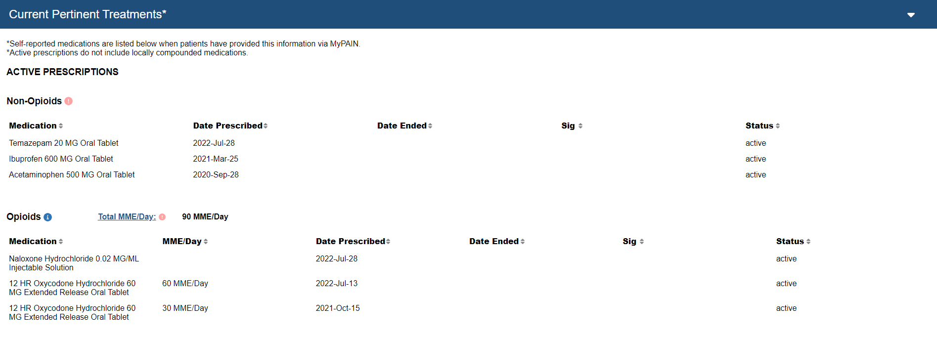
Before: Top part of Current Pertinent Treatments section

Slide 9

Chart Review
Snapshot
Pain Manger
Note
PDMP
FROM PATIENT VIA MYPAIN (OCT 10, 2022):
FROM HEALTH RECORD:
Pt. Name
Pain & Goals Treatment Effectiveness
Conditions Medications Urine Drug Screen
Where is this data from? From the medication list. Only includes NIH designated pain medications. Does not include locally compounded medications.
Active Pain-Related Medications
MME >= 50 CDC Guidelines for Prescribing Opioids
Opioids | MME/Day | Sig | Date prescribed | Status
Oxycodone 60 mg tab | 30 |  | 2022-Jun-25 | active
Norco 60 mg tab | 30 |  | 2022-Jun-25 | active
Non-Opioids |  | Sig | Date prescribed | Status
Aspirin 325 mg tab |  |  | 2022-Jun-25 | active
Benzodiazepines |  | Sig | Date prescribed | Status
Benzodiazepine |  |  | 2022-Jun-25 | active
Naloxone |  | Sig | Date prescribed | Status
Naloxone intranasal |  |  | 2022-Jun-25 | active
Notes:
Chris Notes 11.2
-(6) I like the re-design generally (separate tab, less scrolling, visually appealing organization). Experience tells me that this will be made more complex based on the realities of UF Health specific medications that are available/ordered and how the data are stored
@Cara/Julie – I think this is another item that practically may have to get fleshed out in interactions b/w Alphora and UF Health IT and UF Health clinical team members (not just FWM but people like clinical data translator in IDR, perhaps Jax pharmacy informaticists, others) especially as the app gets into a UF test environment. Add as topic at technical team meeting and/or Alphora meeting in order to flesh out what design changes Alphora may be able to start on independently vs. which will need UF Health input. To discuss properly, we will need transparency on current value sets and related filtering within the applications.
Julie Notes 10.19: we did not finish discussing this at the team meeting.
We learned from Bryant that Pain Manager is pulling all active, stopped, completed, on hold, draft, and unknown medication statuses. The “active prescription” heading in Pain Manager is a misnomer because any of those medication statuses could appear under the “active prescription” heading. Bryant said that they could filter these categories on the back end to show only active medications, or whatever we choose to show. Another alternative is to create additional tables below for the different statuses, However, this will be a bigger development effort than filtering on the backend. I do not recommend adding user-filtering to the table. It is a large development effort, and it’s hard to get right.
Bryant mentioned that there are 4 categories of medications in Pain Manager: opioid, non-opioid, naloxone, and benzos. I updated the wireframe to reflect that.
Need to confirm the medication value sets in Pain Manager are up to date and vet with provider like Francisco.
I took a stab at describing where this information comes from. But, it needs to be reviewed for accuracy. We also need the link to the NIH value set if available.
I removed the “data ended” column because my understanding is it is not supported? Need to confirm.
Still unsure if there are benzo and naloxone specific warnings in Pain Manager. If so, I would like to see their wording.
//history//
Notes: Formatted table to improve readability, including lines between medications. (1) put active opioids first, followed by active non-opioids. My understanding is that stopped and completed medications over the past 2 years could also appear in this list. Therefore, I suggest having sections for stopped and completed medications at the bottom of the list. (2) removed date ended column because my understanding is it is not supported. (3) My understanding is there are warnings for extended release and benzos but I do not show those here because I don’t know what they look like in Pain Manager. Suggest they go where the MME warning is above. If multiple warnings are triggered, then they would appear below the MME warning (4) When users click on the underlined MME total in red, they will see the same popup as they would if they clicked the exclamation icon in Pain Manager now. The warning would only appear if MME equal to or over 50. (5) I am unsure how to format medication name and SIG, but they should mimic what is in Epic now. (6) link to CDC prescribing guidelines is provided if opioids are in list.
Feedback:
Alphora: Are my assumptions above correct? Do stopped and completed medications over the past two years appear in the list? Are there any other categories of medications that appear in this list? Is date ended not supported at UF? What do warnings for benzos and extended-release look like?
-know on back end what status is and could filter. We think “active medications” is a misnomer and all would be in this section.
Chris:
Francisco:
Laura: need language around what is shown (pain medications).
Lori:
Ramzi:
Rob:
Cara: there is a whole list of the medications that are in pain manager. (chris – needs to be transparent and up to date). Bryant: pull medication requests and report them. Valuesets being pulled from nih). Could be transparent about.

Slide 10
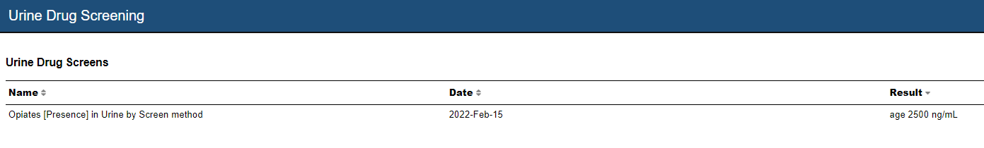
Before: Urine Drug Screening section

Slide 11
Chart Review
Snapshot
Pain Manger
Note
PDMP
FROM PATIENT VIA MYPAIN (OCT 10, 2022):
FROM HEALTH RECORD:
Pt. Name
Pain & Goals Treatment Effectiveness
Conditions Medications Urine Drug Screen
Where is this data from? Lab results for urine drug screens.
Test Date | Test Name | Substance | Result | Value
12-Feb-2022 | Test name | opiates | present | 2500 ng / mL
 |  | cocaine | absent | 0 ng / mL
12-Oct-2021 | Test name | opiates | present | 2500 ng / mL
 |  | cocaine | absent | 0 ng / mL
Notes:
Chris Notes 11.2
-(2)I like the re-design generally (separate tab, less scrolling, visually appealing organization). Experience tells me that this will be made more complex based on the realities of UF Health specific lab tests that are available/ordered and how they get resulted. @Cara/Julie – I think this is another item that practically may have to get fleshed out in interactions b/w Alphora and UF Health IT and clinical team members (e.g., clinical data translator, lab informaticists, etc.) especially as the app gets into a UF test environment. Add as topic at technical team meeting and/or Alphora meeting in order to flesh out what design changes Alphora may be able to start on vs. which will need UF Health input. To discuss properly, we will need transparency on current value sets and related filtering within the applications.
Julie Notes 10.19: we did not get to discuss this at the team meeting.
(1) It’s my understanding that Pain Manager shows UDS from past year. It’s unclear how this would be displayed in Pain Manager (it currently only shows the result of one substance from one test, so I’ve taken a stab here.
(2) I’ve taken a stab at describing where the data is from. I don’t know if this is accurate. Someone mentioned results from outside labs might be pdfs in the record, but those wouldn’t show here I don’t think. I don’t know if it makes sense to add a disclaimer about that, because I don’t know how common it is.
//history//
Notes: It’s my understanding that Pain Manager shows UDS from past year. It’s unclear how this would be displayed in Pain Manager, so I’ve taken a stab here and adjusted the table layout for readability.
Feedback:
Alphora:
Chris:
Francisco:
Laura:
Lori:
Ramzi:
Rob:

